Slide 1
Community Leadership for a Changing Economy
A New Game Plan for Alabama
Joe A. Sumners, Ph.D.
Executive Director
Notes:
11

Slide 3
Economic Vitality: SEC State Standings

Slide 4
Population Change (2000-2018)
Population Growth
TX | FL | GA | SC | TN | SEC | US | AR | KY | AL | MO | MS | LA
36.7 | 33.3 | 28.5 | 26.7 | 19.0 | 17.0 | 16.3 | 12.7 | 10.6 | 9.9 | 9.5 | 5.0 | 4.3
Population Change (2010-2018)
TX | FL | SC | GA | TN | SEC | US | AR | KY | LA | MO | AL | MS
14.1 | 13.3 | 9.9 | 8.6 | 6.7 | 6.1 | 6.0 | 3.4 | 3.0 | 2.8 | 2.3 | 2.3 | 0.6
Source: US Census

Slide 5
Percent of Adults (+25) who Have Completed HS (2013-2017)
Workforce Readiness
MO | FL | US | SC | TN | GA | SEC | AR | AL | KY | LA | MS | TX
89.2 | 87.6 | 87.3 | 86.5 | 86.5 | 86.3 | 85.7 | 85.6 | 85.3 | 85.2 | 84.3 | 83.4 | 82.8
Percent of Adults (+25) with Bachelor’s Degree or More (2013-2017)
US | GA | TX | FL | MO | SC | TN | SEC | AL | LA | KY | AR | MS
30.9 | 29.9 | 28.7 | 28.5 | 28.2 | 27.0 | 26.1 | 25.7 | 24.5 | 23.4 | 23.2 | 22.0 | 21.3
Source: U.S. Census, American Community Survey 5-year Estimates

Slide 6
Median Household Income (2013-2017)
State | Med HH $ | % of Nation
National Average | $57,652
Texas | $57,051 | 99
Georgia | $52,977 | 90
Missouri | $51,542 | 89
Florida | $50,883 | 88
South Carolina | $48,781 | 85
Tennessee | $48,708 | 84
SEC Average | $48,680 | 84
Louisiana | $46,710 | 81
Kentucky | $46,535 | 81
Alabama | $46,472 | 81
Arkansas | $43,813 | 76
Mississippi | $42,009 | 73
Source: U.S. Census, American Community Survey 5-year Estimates

Slide 7
Job Growth
Job Change (2007-2016)
TX | FL | US | TN | GA | SC | SEC | LA | KY | MO | MS | AR | AL
15.4 | 10.0 | 5.1 | 4.7 | 4.3 | 4.1 | 3.9 | 3.8 | 3.4 | 1.5 | -0.2 | -0.7 | -2.9
Job Change (2012-2016)
FL | GA | TX | SC | TN | US | SEC | KY | MO | AL | MS | AR | LA
17.6 | 12.2 | 11.5 | 10.8 | 10.6 | 9.3 | 8.9 | 8.2 | 7.5 | 5.5 | 4.9 | 4.5 | 3.9
Source: US Census, County Business Patterns

Slide 8
Standings – Economic Vitality
Rank | State
1 | Florida
2 | Texas
3 | Georgia
4 | South Carolina
5 | Tennessee
6 | Missouri
7 | Kentucky
8 | Louisiana
9 | Alabama
10 | Arkansas
11 | Mississippi

Slide 9
What Would it Take for Alabama to Be the Southern Benchmark for Success?

Slide 10
What it Takes
Vision and Leadership
Talent
Strategy and Teamwork
Investment

Slide 11
Vision and Leadership
“I think everybody should take the attitude that we’re working to be a champion in everything that we do. Every choice, every decision, everything we do every day, we want to be a champion.”
- Nick Saban

Slide 12
Alabama Vision?
“Tyranny of Low Expectations”
or
Southern Benchmark for Economic Prosperity and Quality of Life

Slide 13

Alabama Vision and Leadership
“For a very long time, our state’s political leaders have failed Alabama citizens. Rather than inspiring us to conquer the barriers that hold the state back, Alabama’s elected officials too often appeal to the worst in us . . . We can do better.”

Slide 14

Alabama Vision

Slide 15
Talent
“We have three kinds of guys on our team. We have the guys that get it; they play good; they understand how to play winning football. We have some guys that are trying to get it, and they are working hard every day. We are supporting them, and we want the guys that have it to support them. Then we have some guys that don’t get it and don’t know that they don’t get it. We are trying to replace them.”
- Nick Saban

Slide 16
Talent Recruitment
“In business today, no competition is tougher than the global race for talent. In every industry, every job sector, and every part of the world, employers are asking the same question: “How are we going to find, train, and retain the best workers?’”
- U.S. Chamber of Commerce 2013

Slide 17


w
Talent
“States and communities that fail to produce and attract educated and skilled workers are at a huge disadvantage in the competitive world of economic development, which is increasingly shifting from an emphasis on recruiting industry to recruiting talent.”

Slide 18

Evolution of Economy
1st Wave: Agriculture Economy
2nd Wave: Manufacturing
Economy
3rd Wave: Information-based Economy
1980
Notes:
18

Slide 19


Globalization and Technology
“National recovery won’t bring jobs back to the rural South. Production has moved to other countries with lower wages, or plants have substituted technologically advanced machines for people. Tens of thousands of jobs are not coming back.”
“The State of the South 2002: Shadows in the Sunbelt Revisited” (MDC, Inc.)
Notes:
19

Slide 20
Innovation and Technology
The U.S. has led the world in its ability to apply new methods and techniques to solve fundamental problems.
Between 1960 and 1999, manufacturing's share of American total employment roughly halved (to about 15%). Yet in those same 40 years manufacturing’s physical output nearly tripled.
Today manufacturing accounts for less than 9% of total U.S. employment.

Slide 21
Moore’s Law
Technology growth is on an exponential curve.
Gordon Moore, founder of Intel, observed that “the number of transistors per square inch on Integrated circuits has doubled every year” (1965).
“If a 1971 VW Beetle were subject to Moore’s Law, today the Beetle would go 300,000 MPH, get 2 million miles on a gallon of gas, and cost 4 cents.” (Thomas Friedman , Thank You for Being Late, 2016)

Slide 22

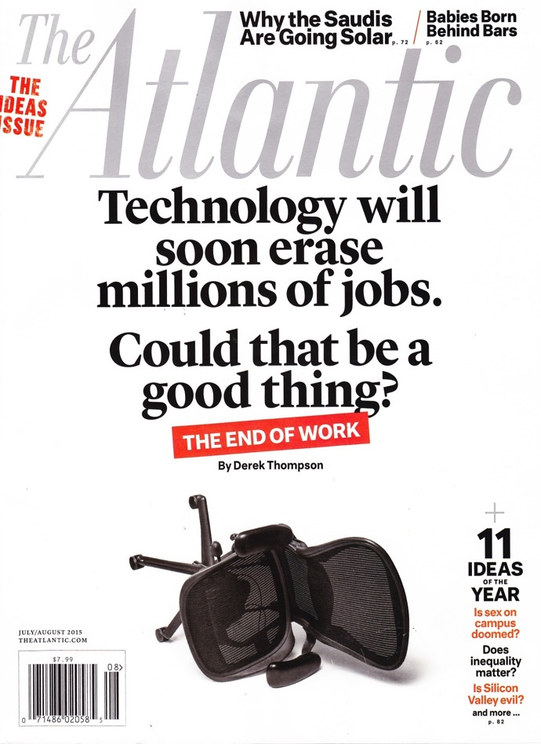

Slide 23
Alabama Education Spending Per Pupil as a Percent of the National Average
1890 | 28%
1900 | 17
1910 | 33
1920 | 39
1930 | 43
1940 | 37
2008 | 81
2011 | 83
2016 | 78
Notes:
23

Slide 24
Strategy and Teamwork
“You can’t win together if you don’t work together.”
- Nick Saban

Slide 25

w
Strategy and Teamwork
“One of the most common deficiencies we find in many Alabama communities is ‘disconnectedness’. There are many excellent people, programs, and projects, but individuals and organizations often work independently, rather than in concert with one another.”

Slide 26



Mega Trends that Impact our Economy & Workforce
1901 Alabama Constitution
26

Slide 27
The 1901 Constitution
Two primary goals of the framers:
Strip blacks (and poor whites) of all political power.
Limit the power of government.
To preserve the economic and political power of property owners by:
Protected vested interests by placing legislative acts in the Constitution (strangled government).
Preserving low taxes on property
Limiting government regulation of business
Concentrating political power in Montgomery
(no home rule)
27

Slide 28

Legacy: Racial Division
“But if we would have white supremacy,
we must establish it by law.”
- John Knox, President of 1901 Alabama Constitution Convention
Constitution of 1901
WHITE SUPREMACY
Low taxes and limited government
Centralized decision making in Montgomery
Over 900 amendments
28
Notes:
28

Slide 29
Legacy: Roadblocks
The Alabama Constitution is “strangled in specifics,” resulting in:
Preservation of the status quo
Low taxes
Limits on the power of the Legislature to act
No public improvements; strict debt limits
933 amendments
Attempts to loosen the original restrictions
29
Notes:
29

Slide 30

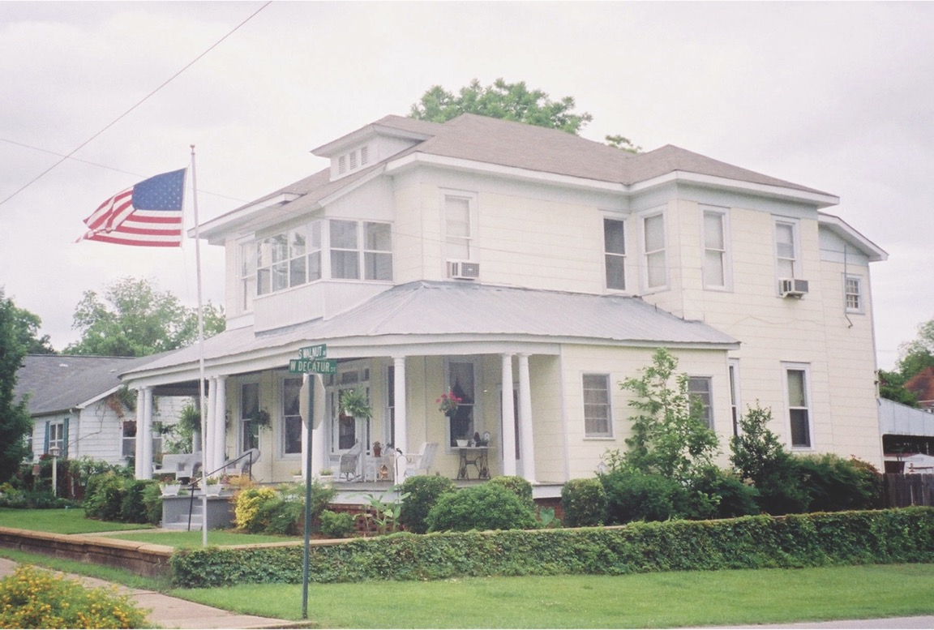
Rural Alabama

Slide 31
Two Alabamas
Alabama Commerce Commission (2000):
“Clearly, there are two Alabamas, one urban and one rural. The first is enjoying relative success, although there are deeply distressed pockets within our urban areas. The second, for the most part, is making little or no progress and continues to keep Alabama from being recognized as a successful competitor.”
Rural counties have:
A greater percentage of population over 65 years of age
Higher unemployment
Lower median family incomes
Lower percentages of high school graduates
Lower average ACT and SAT scores

Slide 32
The Alabama Divide
Source: U.S. Census, Community Survey 2012-2016
 | Metro Counties (over 100,000 population) | Rural Counties (under 25,000 population)
Population growth, 2000-2017 | +20% | -10%
Adults age 25 and older with less than HS diploma | 13% | 22%
Adults age 25 and older with a college degree or more | 28% | 13%
Median household income | $48,748 | $32,291
Percent below poverty level | 16% | 25%

Slide 33
The Alabama Divide
Source: U.S. Census, Community Survey 2012-2016
 | Metro Counties (over 100,000 population) | Rural Counties (under 25,000 population)
Population growth, 2000-2017 | Baldwin +51% Shelby +49 Madison +44 | Perry -21% Macon -22 Lowndes -25
Adults age 25 and older with less than HS diploma | Shelby 8% Madison 9 Baldwin 10 | Coosa 27% DeKalb 27 Bullock 33
Adults age 25 and older with a college degree or more | Shelby 41% Madison 41 Lee 34 | Coosa 10% Washington 10 Conecuh 9
Median household income | Shelby $72,310 Madison $60,150 St. Clair $54,042 | Wilcox $24,442 Greene $21,339 Sumter $20,428
Percent below poverty level | Shelby 8% Baldwin 12 St. Clair 12 | Greene 34% Perry 35 Dallas 35

Slide 34
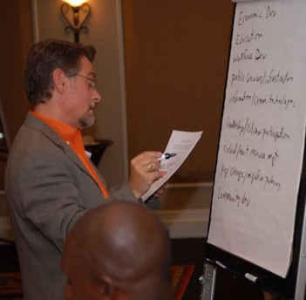
Alabama Rural Roundtable
June 16, 2006, Auburn University
“Priorities for Strengthening the Future of Rural Alabama”
Leadership & Citizen Participation
(civic infrastructure)
Workforce Development & Education
(human infrastructure)
Infrastructure & Communications Technology
(physical infrastructure)
2nd Alabama Rural Roundtable (November 16, 2017)
Same Priorities as 2006 - with addition of Rural Healthcare

Slide 35
Investment
"The reality for all our sports is you have to look into re-investing in your success. We have a lot of really good facilities at Alabama. We have a great footprint. At the same time, you just can't be satisfied with that. You can't say we have everything we need. Things need to be updated and continue to evolve. Facilities are an important part of that.”
- Greg Byrne, UA Athletics Director

Slide 36

Light Tax Burden
The total state and local tax burden in Alabama is the lowest in the nation.
Alabama property taxes are by far the lowest in the nation.
Would have to almost triple just to meet the national average.
36

Slide 37
State and Local Revenues Per Capita, SEC Home States, 2015 Source: Tax Policy Center, Urban Institute & Brookings Institution
 | Taxes per capita | National Rank | If AL taxed like . . .
Alabama | $3,144 | 50
Texas | 4,126 | 28 | + $4.8 billion
Louisiana | 3,951 | 33 | + $3.9 billion
Arkansas | 3,868 | 34 | + $3.5 billion
Kentucky | 3,782 | 38 | + $3.1 billion
Mississippi | 3,673 | 40 | + $2.6 billion
Missouri | 3,649 | 41 | + $2.5 billion
Georgia | 3,520 | 43 | + $1.8 billion
Florida | 3,453 | 46 | + $1.5 billion
South Carolina | 3,426 | 48 | + $1.4 billion
Tennessee | 3,270 | 49 | + $612 million
Other SEC State Average | 3,672 |  | + $2.6 billion
National Average | 4,883 |  | + $8.4 billion
Note: Total Alabama General Fund budget for FY19 is $2 billion.

Slide 38
2 Corinthians 9:6
“Whoever sows sparingly will also reap sparingly, and whoever sows bountifully will also reap bountifully.”

Slide 39

Our Choice
“Make no mistake, mediocracy is not our fate; it has been our choice.”
39

Slide 40
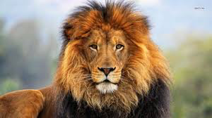
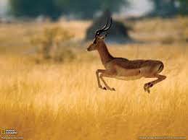
“Every morning in Africa, a gazelle wakes up. It knows it must run faster than the fastest lion or it will be killed. Every morning a lion wakes up. It knows it must outrun the slowest gazelle or it will starve to death. It doesn’t matter whether you are a lion or a gazelle. When the sun comes up, you better start running.”
- African proverb
Thomas Friedman, The World is Flat, 2005)
Notes:
40

Slide 41
What it Takes
Vision and Leadership
Talent
Strategy and Teamwork
Investment

Slide 42


Our Choice
“The state of Alabama is once again at a crossroad . . . The question facing us is, will we strive to be champions, or once again be willing to settle for less – content in our state of low expectations.”
42

Slide 43




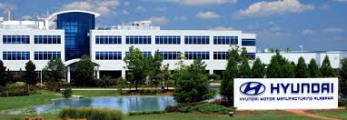







Slide 44
Our Opportunity
“If our political leaders will embrace a greater vision for Alabama and commit to the highest standards of excellence in public service, then Alabama has the chance to be the best in more than just college football.”

Slide 45

Download Alabama Issues 2018 at:
http://www.auburn.edu/gedi/documents/publications/alabama-issues-2018.pdf

Slide 46


Joe A. Sumners, Ph.D.
Executive Director
334-844-4704
sumneja@auburn.edu

