Slide 1

HOW TO RECORD & ADD YOUR VIDEO
Copyright © StartupWind, 2016-2023

Slide 2
4 Steps to Upload Video: Using YouTube URL
Upload your Video to YouTube
Get the YouTube URL
Go to your Business Plan
Enter the YouTube URL under “Add your pitch video from YouTube”

Slide 3
#1&2 Upload Video to YouTube & Copy URL
Instruction from YouTube about how to Upload:
https://youtu.be/6C4dEpT0rYg
Upload your video to YouTube:
Sign-in to YouTube Studio http://studio.youtube.com/
In the top right-hand corner, click CREATE and then Upload video
Select the file you’d like to upload.
Add basic information
Preview and Publish
Copy the YouTube URL from the preview page

Slide 4
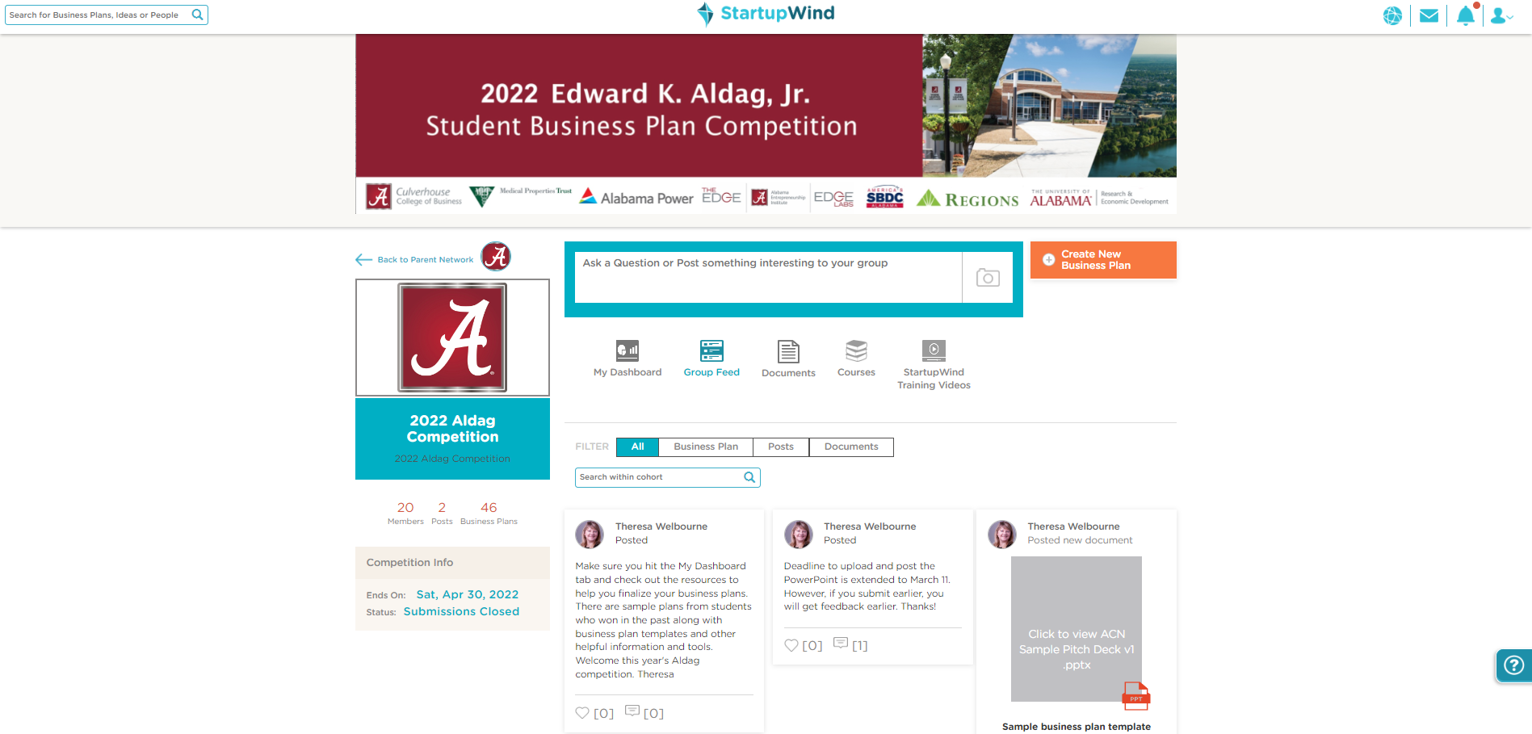

#3 Go to your Business Plan
Go to the Faculty /Staff competition site (we will add site to this document)
Click on your Business Plan Card (example – card with red border)
2023 Faculty | Staff Innovative Pitch
Competition
Faculty | Staff Competition

Slide 5
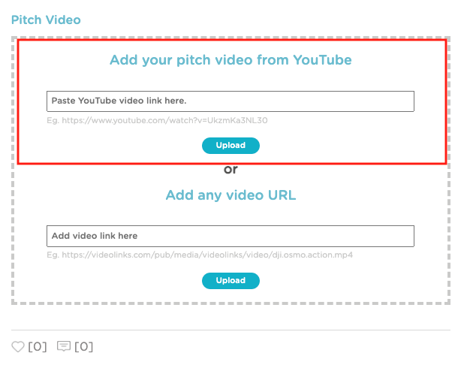
#4. Add YouTube URL
Add your YouTube URL in the box
Click on “Upload”

Slide 6

Your Video is Added to Your Business Plan
Uploaded Video shows in the box

Slide 7
Questions - Contact:
support@startupwind.com
Jenni Miesse, Marketing Manager, AEI | The EDGE
jmiesse@cba.ua.edu
Q&A

