Slide 1
HOW TO ADD VIDEO & PITCH DECK
Copyright © StartupWind, 2016-2023

Slide 2
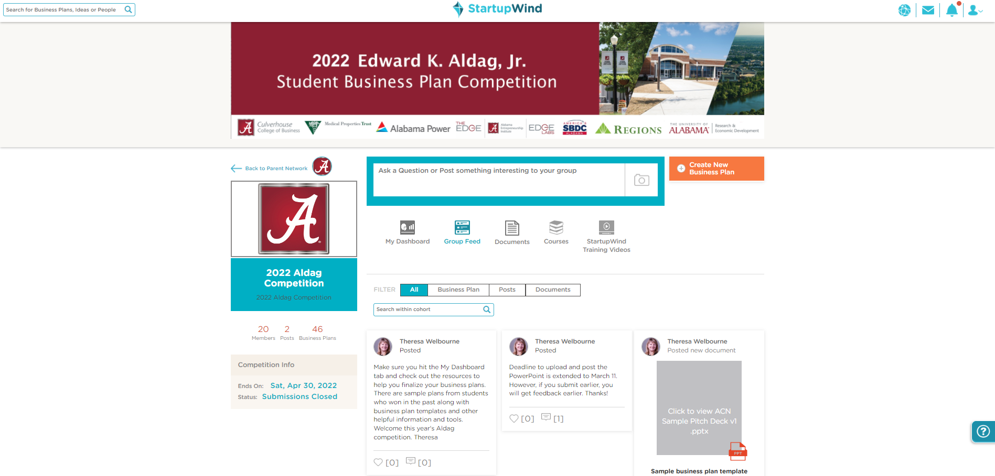

Go to Your Business Plan
Go to https://live.startupwind.com/groups/63d363dfea86be9654aab70a#home
Click on your Business Plan Card (example – card with red border)

Slide 3
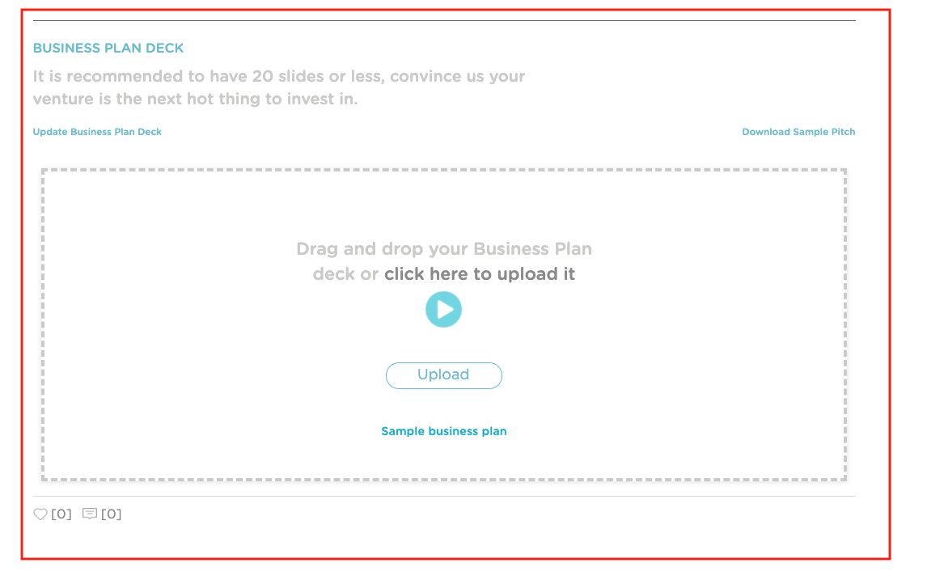
Upload Your Pitch Deck (By Scrolling Down)

Slide 4
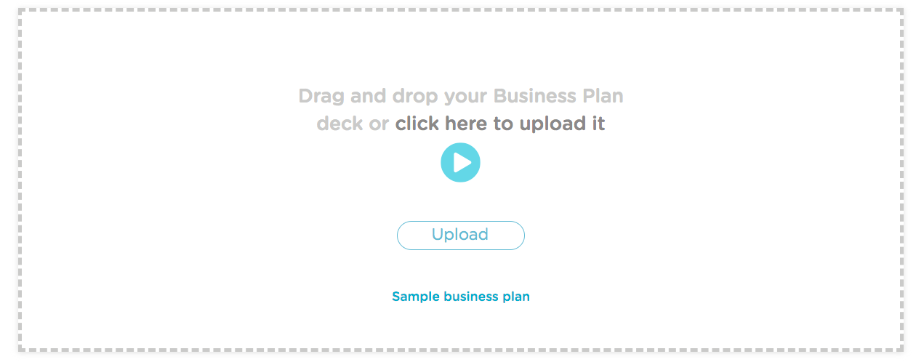
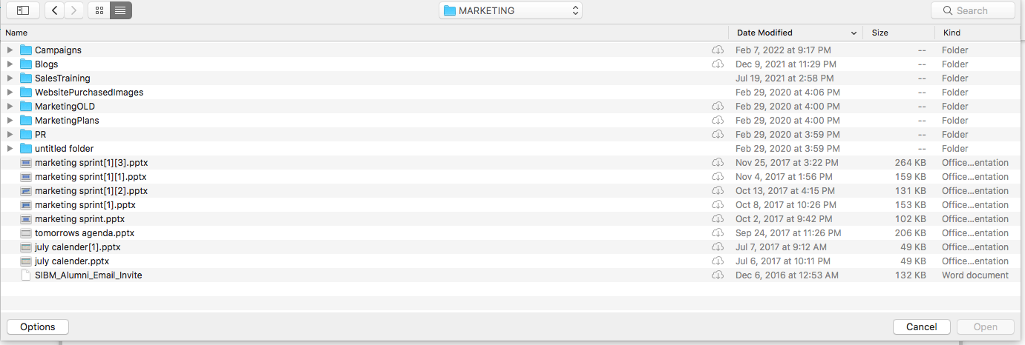
Upload Your Deck
Select the file to upload
Click “Open” to add the file to the plan

Slide 5
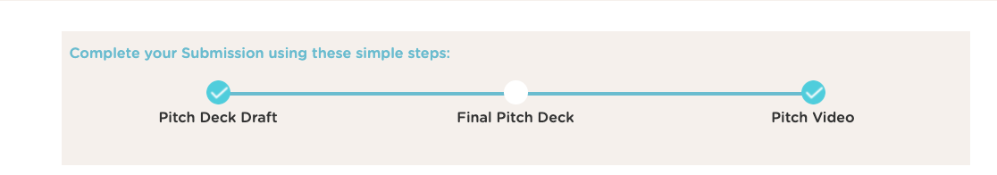
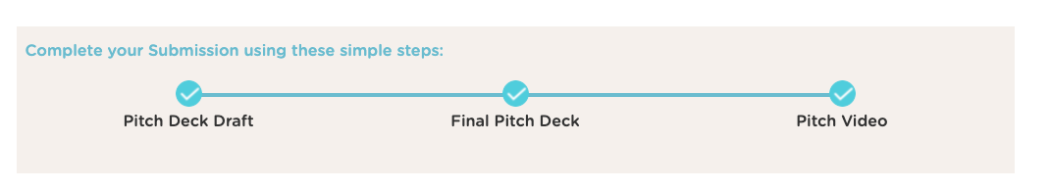
Pitch Deck Upload - Status
  1st time when you add your deck, the bubble on top ”Pitch Deck Draft” will marked completed.
  2nd time when you add your deck, the bubble on top ”Final Deck Draft” will marked completed.

Slide 6
4 Steps to Upload Video: Using YouTube URL
Upload your Video to YouTube
Get the YouTube URL
Go to your Business Plan
Enter the YouTube URL under “Add your pitch video from YouTube”

Slide 7
#1&2 Upload Video to YouTube & Copy URL
Instruction from YouTube about how to Upload:
  https://youtu.be/6C4dEpT0rYg
Upload your video to YouTube:
  Sign into YouTube Studio: http://studio.youtube.com/
  In the top right-hand corner, click CREATE and then Upload video
  Select the file you’d like to upload.
  Add basic information
  Preview and Publish
Copy the YouTube URL from the preview page

Slide 8
#3 Go to Your Business Plan
Go to https://live.startupwind.com/groups/61f762064828578e33a4255c#home
Click on your Business Plan Card (example – card with red border)

Slide 9
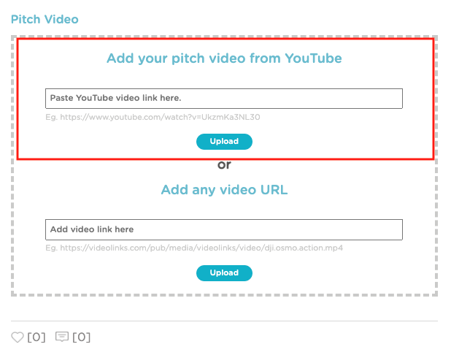
#4. Add YouTube URL
Add your YouTube URL in the box
Click on “Upload”

Slide 10

Your Video is Added to Your Business Plan
Uploaded Video shows in the box.

Slide 11
Questions - Contact:
support@startupwind.com
Jenni Miesse, Marketing Manager, AEI | The EDGE
jmiesse@cba.ua.edu
Q&A

